Slide 1
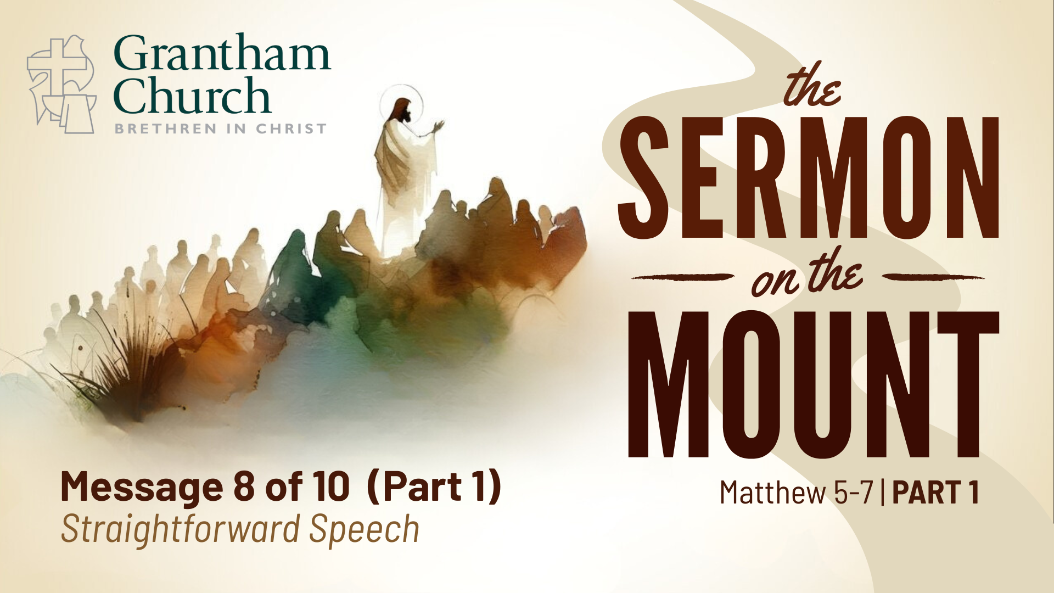
Notes:
I was listening to a podcast episode the other week from This American Life called “My Other Self” where a reporter, Evan Ratliff, created an AI version of himself and was testing to see if it could replace him in various types of phone calls. So, he starts by using it with customer service representatives, but then feels bad about bothering them when they’re just trying to do their jobs so he tests it on scammers and telemarketers to put it back at them and scam them. And he gets some chuckle out of that. And then he tests it on a lawyer friend to get some legal advice. And then he starts to wonder if this could do other parts of his job like interviews. He’s a reporter, so he puts out a request for people to call him if they’re wiling to be interviewed about how they feel about AI, not knowing Evan would use his AI voice to do the interview. He’s intrigued by the reaction people have in that moment of realization when they learn that it’s not a real person they’re talking with, but it’s AI. And one of the callers hit that point and was like “oh, I may be talking to AI right now” and tried to question robot Evan about if it was AI (he programed the AI not to expose itself as AI). And after their call ended, she called back and apologized for accusing him of being AI, and said “I’m sorry if that was insulting.” And real Evan was struck by this, you know, the humanity of someone calling back to apologize just in case it wasn’t AI.
Our default mode is to trust others, right. And that should be our default mode. We should be able to trust each other. But we’re in a society where it’s become incredibly difficult to know what’s real and what’s true. And it’s becoming more and more common to question what other people say and wonder if they’re speaking the truth. And then when it comes to promises and commitments we struggle to trust each other, because so many people haven’t followed through. So many have said one thing and done another or twisted their meaning or fooled us into thinking they were trustworthy.
Well, today as we continue in our series on the Sermon on the Mount, the summation of Jesus’ greatest teachings, we’re going to look at this section in Matthew 5 about oaths. No, Jesus doesn’t specifically address generative AI and whether we should be using it, but he does challenge his followers to think about their speech and our tendencies to be deceptive with our words.
This passage is part of the section of the sermon where Jesus is laying out a vision for righteousness and the best way to do right by people. We’ve heard this pattern of “you’ve heard it said…, but I tell you…” and there are 6 times Jesus does this as a way of addressing the letter of the law and what religious people would have heard from the Pharisees and teachers of the law, but exposing the spirit or intention of the law and helping people to see how they were using the law in the wrong way.
The law was intended to express the heart and character of God and guide God’s people into a way of life that is holy and whole and beautiful where others would look and be drawn to that community and ultimately drawn to the holiness and beauty of God. But it was becoming something that was used to keep people out or away from God and even avoid what was right. So, Jesus is repainting the vision of a compelling community that points others to God.
And these 6 case studies for righteous living are all part of working out what it means to be salt and light in the world, to be different for the sake of world. So, we’re different in that we don’t just care about murder, but we care about the anger and hatred in our hearts. And we’re different because we don’t just try to stay faithful externally, but we seek to cut off temptation at the root and stay faithful internally. And we’re different because we take seriously our commitments in marriage and we don’t try to look for an easy way out. And this week goes even further into this idea of commitment and being true to our word and how we’re different because we’re not trying to find ways to spin the truth or fool others or renege on our promises.

Slide 2
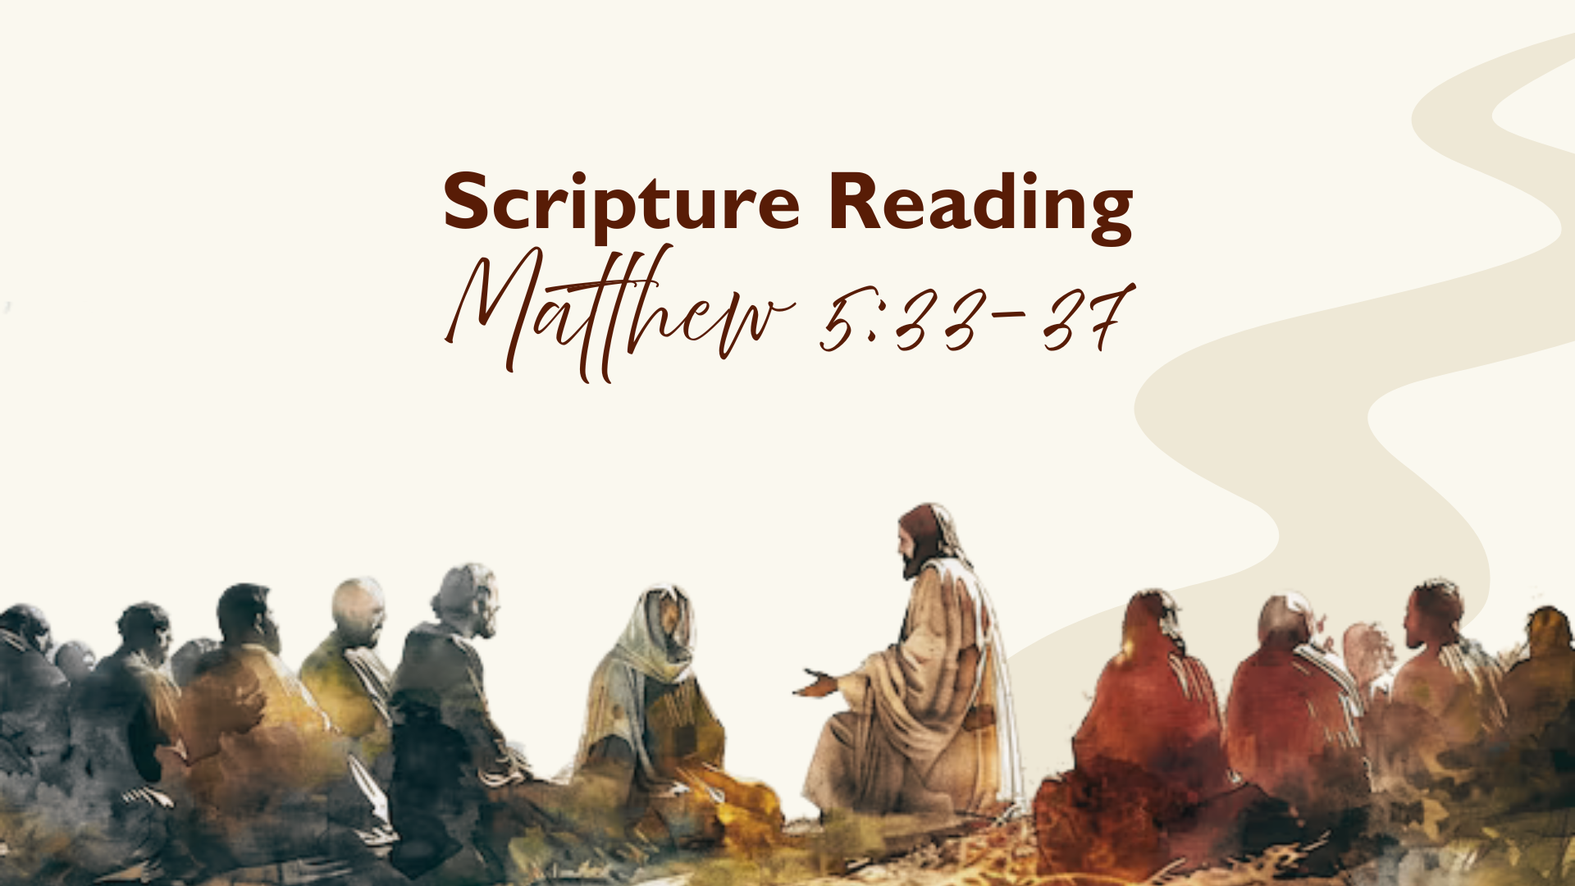
Notes:
So, let’s READ Matthew 5:33-37
Jesus begins by referring back to what the Jewish people would have recognized as a common teaching of the law. “Don’t break your oath, but fulfill the vows you’ve made to the Lord.” And this isn’t a direct quote from the OT law, but it’s a summary of a few laws

Slide 3
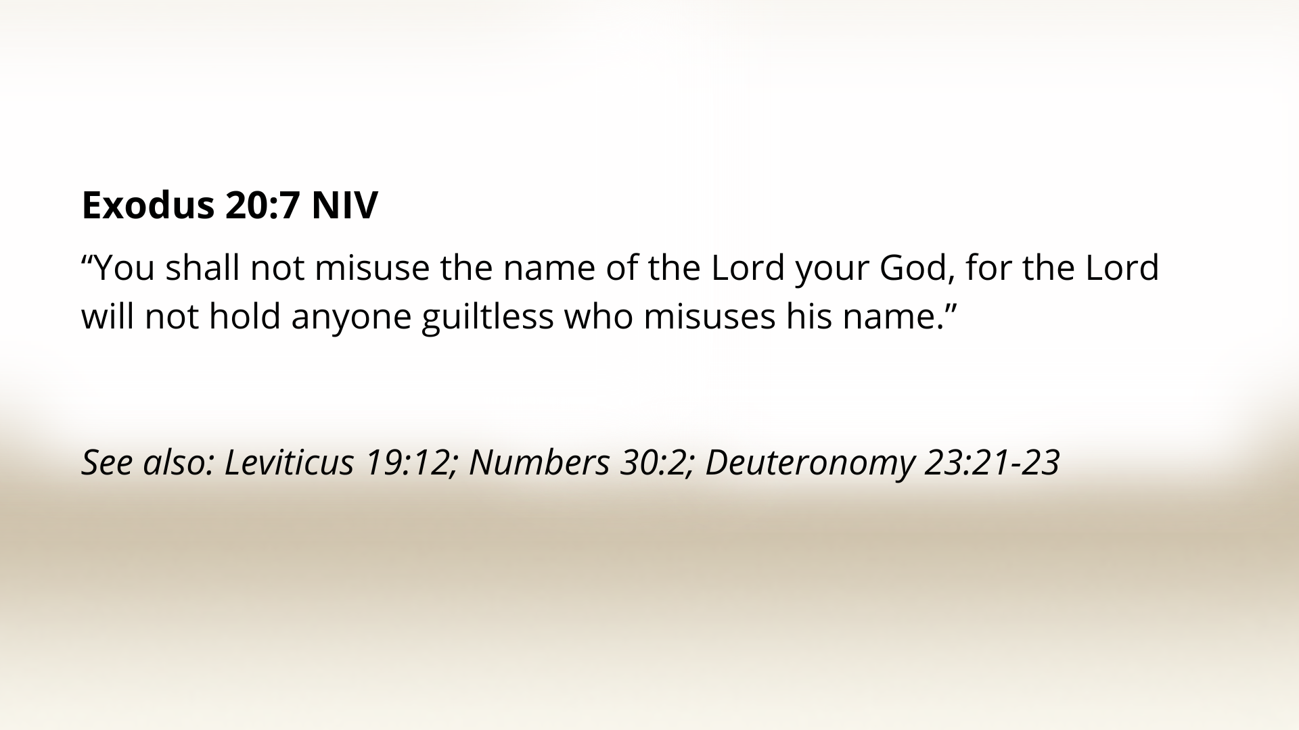
Notes:
all going back to the 10 commandments and Ex 20:7 “You shall not misuse the name of the Lord your God, for the Lord will not hold anyone guiltless who misuses his name.”
So, in ancient Israel when someone would invoke the name of God/Yahweh in an oath, they didn’t want to disgrace God’s name, so it meant something. It’s like they were making that promise to God and saying God would hold them accountable. The original intent of the Mosaic law was to help God’s people recognize the importance of their words and remind them that what they said and did was under God’s oversight and reflected on him.
So, if an ancient Israelite would say to their friend: “hey, can I borrow your donkey? I swear on the name of Yahweh that I’ll return it next week.” It’s like saying “you can trust me, because the law says I need to fulfill my promises to God.”
But, because humans are humans, they started looking for ways out of their promises.
And what ancient Israel began to do is move away from using the name of God in daily communication so as to respect the name of Yahweh, but what this turned into in their promises/oaths is that they would swear on things that were God-adjacent, related to God, like heaven or earth or Jerusalem (where the temple was). And then when that friend would come back to pick up their donkey next week, the one who made the promise would say “I didn’t use the name of Yahweh, I just swore by the temple, so it doesn’t really hold the same weight.” And they would do this as a way of manipulating others. It was a way of using God’s reputation as a tool for manipulation. They were using God to increase the gravitas of what they were saying, to get others to believe them so they could have their way, but then pulling back and saying “it wasn’t really invoking God, you just believed it that way” and putting the burden on the other person to judge if they were trustworthy.

Slide 4
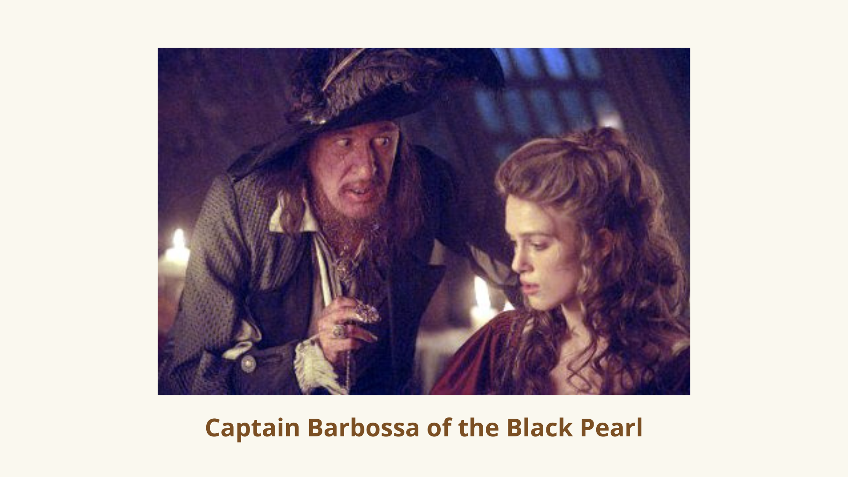
Notes:
If you’ve seen the Pirates of the Caribbean you might remember the scene when Elizabeth Swann, who had been captured by Barbossa and the Black Pearl, is being led onto the plank. Will Turner says to captain Barbossa: “You swore she’d go free.” And Barbossa replies: “Don’t impugn me honor. I agreed she’d go free, but it was you who failed to specify when or where.”
This is what Jesus is getting at: saying one thing and meaning another. Putting the burden on the other person to decide if they can trust you. And using God to manipulate others so you can get what you want.

Slide 5
Notes:
What does this look like for us today? People say “I swear to God. or, on a stack of Bibles.” To try to convince someone they’re telling the truth. But, this happens much more subtly oftentimes, doesn’t it? In the church, we can say: “God told me…” to do this, to tell you this, to make this decision. Leadership in the church can do this “we think God is leading us this way…” to try to get others to follow. We’ll tell someone “I’ll pray for you” and not follow through. Or “Let me pray about that” which is often code for no. And I’m not saying all these uses are illegitimate or that God doesn’t speak to us or we shouldn’t bring God into our conversations. But, we need to be very aware of our tendency to push our way through. To manipulate others or even deceive ourselves into thinking God wants what we want. We just need to be so careful with this. And to do our best to honor the other person by being transparent and honest, and being open to feedback and accountability. We want to let others know our intensions as much as we’re able and not pull the “God card” in an attempt to overpower another.

Slide 6

Notes:
Jesus says in v. 34 it’s better not to swear an oath at all. Some Anabaptists take this to believe that one shouldn’t even swear under oath in a court of law. Now, I think we can recognize that there are positive oaths in Scripture. In the Abrahamic Covenant in Gen 22, God’s promises to Abraham, God swears by himself to bless Abraham. At Jesus’ trial before his crucifixion, Caiaphas charges Jesus under “oath by the living God” to say if he is the Messiah (Matthew 26:63). Jesus doesn’t condemn Caiaphas or resist the oath, but he responds to the charge (“you have said so”). There are several times Paul calls upon God as his witness. We still make commitments before God in marriage.
But, Jesus goes on to say: “don’t swear an oath by heaven for it’s God’s throne or earth for it’s his footstool or Jerusalem for it’s the city of the Great King, or your head” (maybe they’d swear by their heads, because that’s not really too close to God, I’m not being too serious about it.) Jesus is basically saying you don’t have any control over your head, what your natural hair color is – the point Jesus is making is that everything is connected to God. God has created and sustained everything. God rules over everything. God is present everywhere. Any promise you make comes back to God as its source.
What the ancient Israelites were trying to do was disconnect these things from God. But, Jesus is saying, “have integrity.” Integrity is about integration. Integrating our understanding of God into every area of our lives. It’s about integrating our words and actions, being consistent with what we say and do. It’s about being the same person in private as we are in public. When we use manipulation and spin, we lack integrity and it causes disintegration. It causes breakdown of that relationship and breakdown of a community. And even breakdown within ourselves. We can convince ourselves that it’s just a little lie or a little twist, but we’re deceiving ourselves. Those patterns of self-deception shape who we are and will eventually come out and affect others.
So, Jesus is saying that we should be straightforward in our speech. Do what we say we’re going to do. Be honest. Have integrity. Simply say “yes” or “no.”
And notice that sometimes it’s a “no.” Some of us struggle with overcommitting and saying yes too much. Sometimes it’s because we want to do a lot of things and struggle to recognize our capacity. Some of us say yes because we don’t want to make someone feel bad in the moment, even though we know eventually we’ll disappoint them. There’s a place for “no,” as well.
One of the best pieces of advice I got when I was a young adult was to remember that whenever you say yes to something, you’re saying no to something else. (e.g. yes to committee means no for time with family; doesn’t mean I don’t say yes to that, but need to be aware of the trade-off. Works other way to… no to helping friend move even if I could, means yes to my selfish idol of comfort/convenience. It works both ways and it requires discernment.) the point is, we need to be straightforward about our intensions and with our words.
And Jesus says anything beyond this (a simple yes or no) comes from evil/the evil one. This is an allusion to Genesis and the evil one in the garden. The snake who twists God’s promise and tricks the humans. “Did God really say you must not eat from any tree in the garden?” No, God said you can eat from any tree except this one. But the snake manipulates to get what he wants. And as fallen humans we do the same thing. Jesus recognizes our tendency to use what is meant to enforce truth (an oath, promise before God) and turn it into an instrument of manipulation, of disintegration and death.
But when we’re honest and consistent and we follow through with what we say, it creates a community of trust and loyalty.

Slide 7
Notes:
A friend of mine shared something this week on the concept of the village and how we all want the village but we don’t want to be villagers. We want to be in a community that is supportive and trustworthy, but we struggle to make the effort to be part of that, because it requires us to help when we don’t feel like it or deal with people that are annoying or let people in our space when it’s inconvenient. It requires that we follow through with our word and we prioritize commitment over keeping our options open.
We like to keep our options open, don’t we. We don’t want to be inconvenienced. We don’t want to miss out on something else more fun. We don’t want our independence to be interrupted. We tend to avoid commitment to gain the advantage of convenience.
But, thanks be to God, our Lord, Jesus Christ, didn’t shy away from commitment. He didn’t prioritize his convenience or his comfort. He was committed to being with us. He was faithful to his promises. He had the highest integrity. Jesus was always looking to integrate, to reconnect with those who had broken promises. He connects with the tax collectors who had broken promises to their people. And he connects with prostitutes who had caused brokenness of marriage covenants. He welcomed in the poor and outcasts and lepers who probably had promises broken to them to care for them. And Jesus reconnects with Peter, his follower who, at the last supper had said he was committed to Jesus to the end, but then denies three times that he even knew Jesus, even with an oath he swears he doesn’t know Jesus. But Jesus integrates Peter back into the fold. And Jesus goes to the cross to prove his commitment to us. And his resurrection is the guarantee that he will follow through with all his promises.
So, for us, this means we don’t have to manipulate. Where we have lied and twisted and not followed through, God is there, God loves us. He’ll forgive us and give us the courage to ask others for forgiveness. And we don’t have to hold back on commitments to others, because God will always come through and give us what we need to follow through with our promises. And we don’t need to worry about missing out on something better. You know, what I’m learning is that the greatest thing ever has already happened in Christ – his death and resurrection and all that comes with that. And there’s ongoing effects of that greatest thing and ongoing ways we’re experiencing resurrection and restoration that God is bringing about in the world and in our lives. So, wherever we are, God is continuing that great work in and through us, so we don’t need to worry about missing out on something else. The greatness is happening right where we are as followers of Jesus if we’re willing to see it and be part of it.

Slide 8
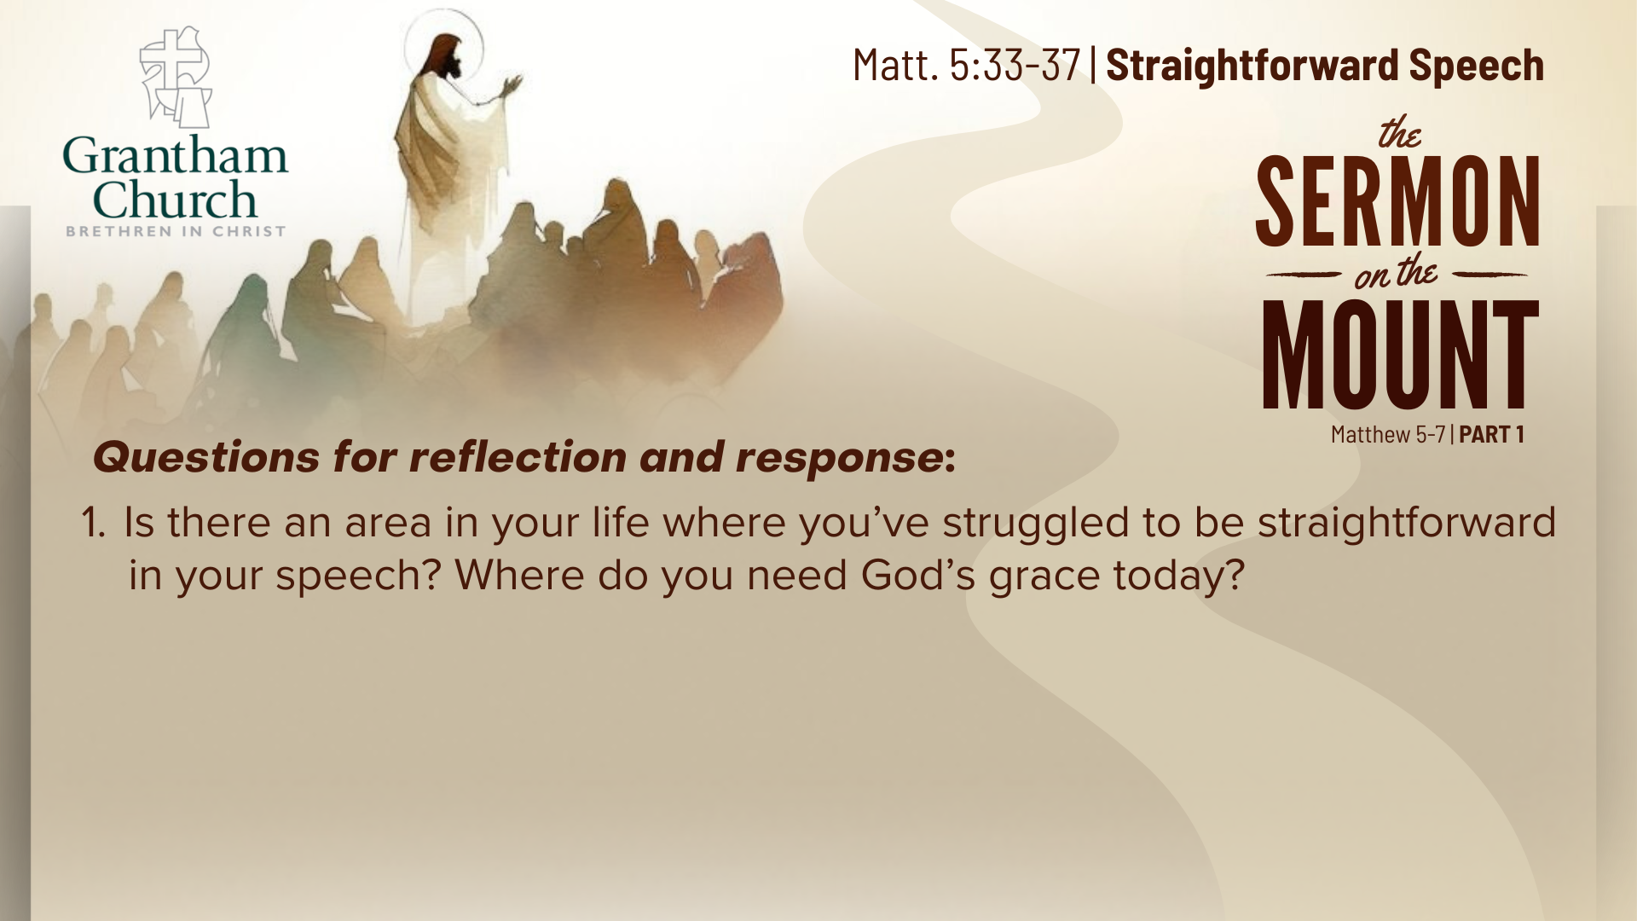
Notes:
Questions for reflection & response:
Is there an area in your life where you’ve struggled to be straightforward in your speech? Where do you need God’s grace today? [he’s waiting to forgive. And it may mean going to someone else, too, and being transparent about the situation, but God will go with you in that.]

Slide 9
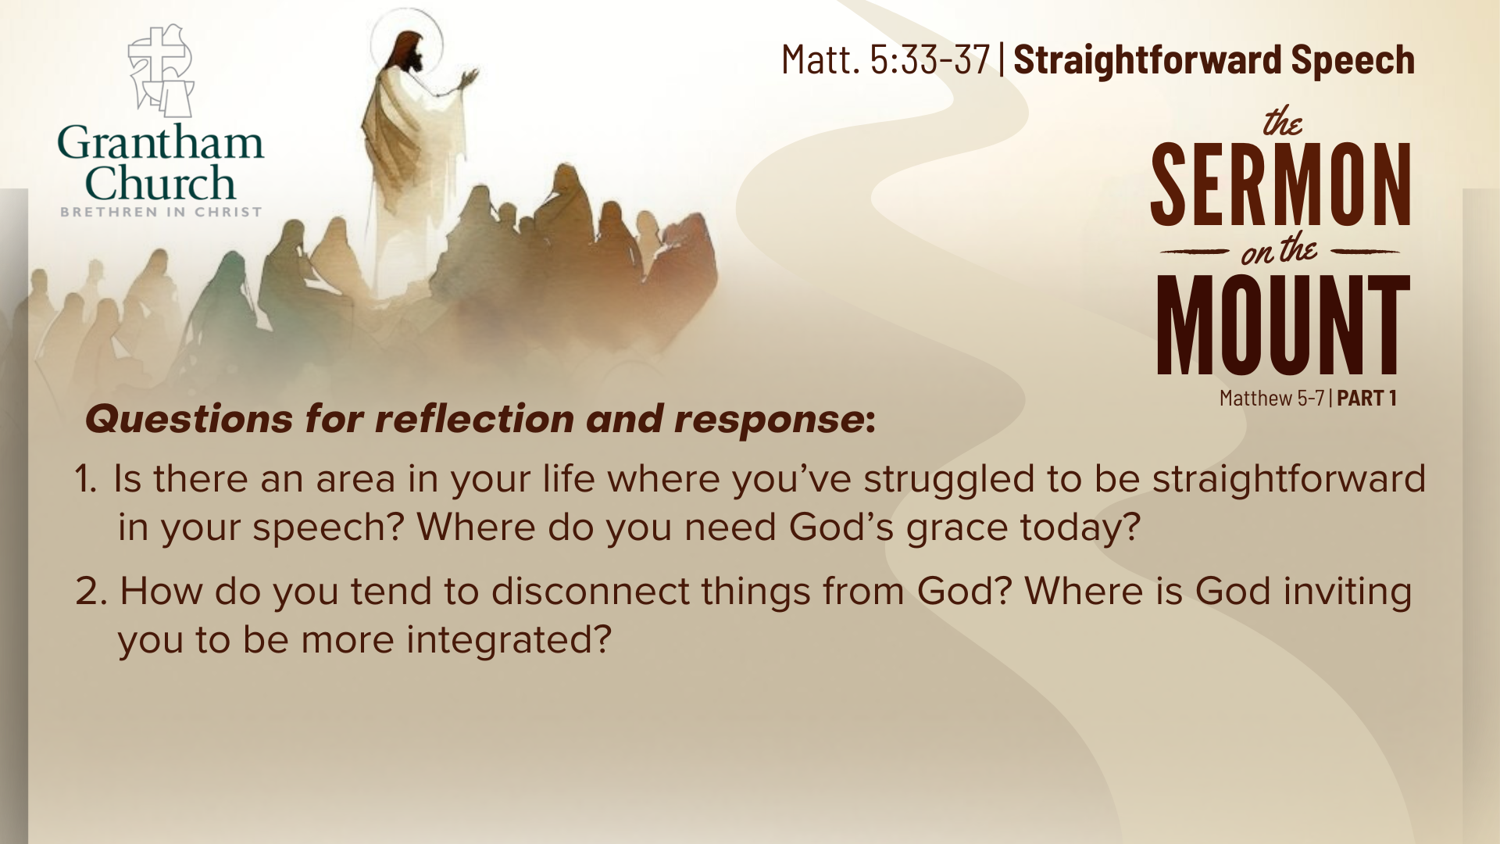
Notes:
How do you tend to disconnect things from God? Where is God inviting you to be more integrated? [and we could ask this collectively as a church, too – where do we tend to disconnect things from God and how does God want us as a body to be more integrated?]

Slide 10
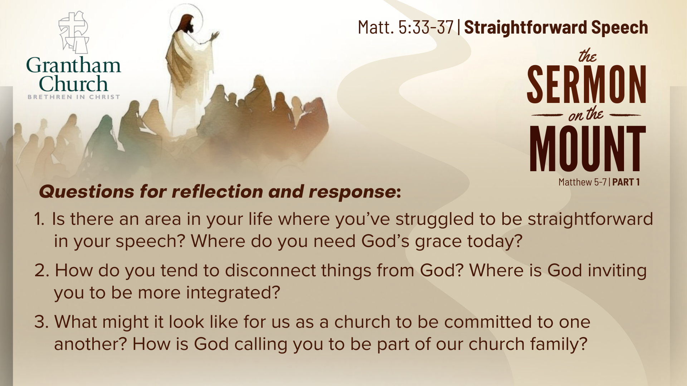
Notes:
What might it look like for us as a church to be committed to one another? [to count on each other to show up and follow through and be true to our word? How can we grow in this?] How is God calling you to be part of our church family [as we seek to be like this]?

Slide 11
Notes:
Closing Illustration….
Oh, that we would be a community like that. A community of trust and grace and commitment because Jesus has been that for us.
That’s a community I believe others would see as compelling. Let’s ask God to make us that kind of people.
PRAY

Slide 12
